Slide 1
Accurate Connections
Ludwig Easton
08/01/2017

Slide 2
Prophetic Word
Hear the Father’s Decree
Exercise Dominion as Sons of God
Demonstrate the Power of the Holy Spirit as vessels of Honour
Build Church Unusual
Birth Zion Invincible
Become Kingdom Unstoppable

Slide 3
The Restoration of the Church
Accurate Connection
Precise Operation
Supernatural Conception
Militant Execution

Slide 4
How Do we relate well in the house (local church)
When we are born again, God adds us to a local church.

Slide 5
Know Who Our Spiritual Parents Are
See Paul and Timothy
Many instructors but one father
1 Tim 1:2
To Timothy, a true son in the faith:
Grace, mercy, and peace from God our Father and Jesus Christ our Lord.
1 Tim 1:8
This charge I commit to you, son Timothy, …

Slide 6
1 Cor 4:14-17
¹⁴ I do not write these things to shame you, but as my beloved children I warn you.
¹⁵ For though you might have ten thousand instructors in Christ, yet you do not have many fathers; for in Christ Jesus I have begotten you through the gospel.
¹⁶ Therefore I urge you, imitate me.
¹⁷ For this reason I have sent Timothy to you, who is my beloved and faithful son in the Lord, who will remind you of my ways in Christ, as I teach everywhere in every church.

Slide 7
Recognise that they are God’s gifts & Appointed by God
Watch out for familiarity
Honour them
1 Timothy 5:17
¹⁷ Let the elders who rule well be counted worthy of double honour, especially those who labour in the word and doctrine.
It has to do with our attitude

Slide 8
Ephesians 4:7-13
⁷ But to each one of us grace was given according to the measure of Christ’s gift.
⁸ Therefore He says:
“When He ascended on high,
He led captivity captive,
And gave gifts to men.”
⁹ (Now this, “He ascended”—what does it mean but that He also first descended into the lower parts of the earth?
¹⁰ He who descended is also the One who ascended far above all the heavens, that He might fill all things.)

Slide 9
¹¹ And He Himself gave some to be apostles, some prophets, some evangelists, and some pastors and teachers,
¹² for the equipping of the saints for the work of ministry, for the edifying of the body of Christ,
¹³ till we all come to the unity of the faith and of the knowledge of the Son of God, to a perfect man, to the measure of the stature of the fullness of Christ;

Slide 10
Recognise Their Gifting & Their Sphere of Authority
Ephesians 3:1-7
¹For this reason I, Paul, the prisoner of Christ Jesus for you Gentiles—
² if indeed you have heard of the dispensation of the grace of God which was given to me for you,
³ how that by revelation He made known to me the mystery (as I have briefly written already,
⁴ by which, when you read, you may understand my knowledge in the mystery of Christ),

Slide 11
⁵ which in other ages was not made known to the sons of men, as it has now been revealed by the Spirit to His holy apostles and prophets:
⁶ that the Gentiles should be fellow heirs, of the same body, and partakers of His promise in Christ through the gospel,
⁷ of which I became a minister according to the gift of the grace of God given to me by the effective working of His power.

Slide 12
2 Corinthians 10:12-18
¹² For we dare not class ourselves or compare ourselves with those who commend themselves. But they, measuring themselves by themselves, and comparing themselves among themselves, are not wise.
¹³ We, however, will not boast beyond measure, but within the limits of the sphere which God appointed us—a sphere which especially includes you.

Slide 13
¹⁴ For we are not overextending ourselves (as though our authority did not extend to you), for it was to you that we came with the gospel of Christ;
¹⁵ not boasting of things beyond measure, that is, in other men’s labours, but having hope, that as your faith is increased, we shall be greatly enlarged by you in our sphere,
¹⁶ to preach the gospel in the regions beyond you, and not to boast in another man’s sphere of accomplishment.

Slide 14
Be Trained & Receive Impartation
Training is not a walk in the park
Abraham trained his household (Gen 14:14)
Impartation is like surfing the waves
The God of Abraham is also the God of Isaac and the God of Isaac is also the God Jacob
Be Faithful with another’s, then receive your own (Luke 16:12)
Joshua can to carry to dimensions of Moses, being continued on by possessing the land

Slide 15
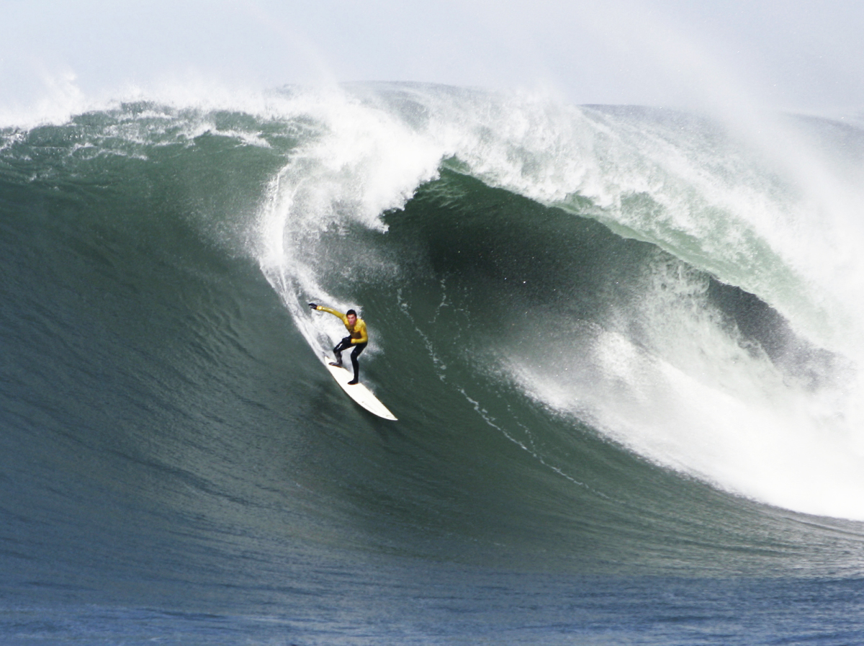

Slide 16
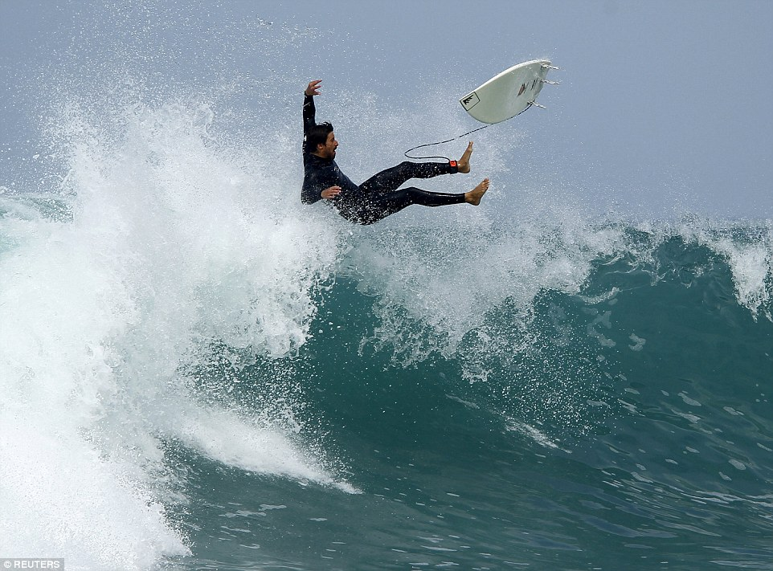

Slide 17
Share The Same Assignment
Same heart, same vision
2 Tim 2:1-2
You therefore, my son, be strong in the grace that is in Christ Jesus. ² And the things that you have heard from me among many witnesses, commit these to faithful men who will be able to teach others also.

Slide 18
Build, Co-labour, Move Together
We are not building our own ministry
We are not in it for what we can get personally
We are building what God is building
After all the input, we must build together, otherwise it’s a waste

Slide 19
Walk In Covenant (JOHN 17)
Jonathan and David
Naomi and Ruth
See the best each in other
Agree and walk together
Loyal to one another because of Him who brings us together

Slide 20
Ruth 1:16-17
¹⁶ But Ruth said:
“Entreat me not to leave you,
Or to turn back from following after you;
For wherever you go, I will go;
And wherever you lodge, I will lodge;
Your people shall be my people,
And your God, my God.
¹⁷ Where you die, I will die,
And there will I be buried.
The Lord do so to me, and more also,
If anything but death parts you and me.”

